Slide 1
Web Technologies

Slide 2
The Internet
The Internet is a vast network that connects computers all over the world. Through the Internet, people can share information and communicate from anywhere with an Internet connection.

Slide 3
Internet service provider(ISP)
An Internet Service Provider (ISP) allows the user access to the Internet through their server.

Slide 4
Internet Service Providers in India
Airtel
Jio
BSNL

Slide 5
TCP / IP Protocols
In order for a computer to communicate on the Internet, a set of rules or protocols computers must follow to exchange messages was developed. The two most important protocols allowing computers to transmit data on the Internet are Transmission Control Protocol (TCP) and Internet Protocol (IP).

Slide 6
Working of TCP / IP Layer
To make sure that each message reaches its target location intact, the TCP/IP model breaks down the data into small bundles and afterward reassembles the bundles into the original message on the opposite end. Sending the information in little bundles of information makes it simpler to maintain efficiency as opposed to sending everything in one go.

Slide 7
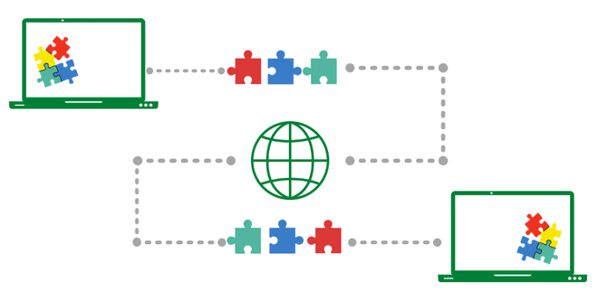

Slide 8
URLs
Addresses for web sites are called URLs (Uniform Resource Locators). Most of them begin with http (HyperText Transfer Protocol), followed by a colon and two slashes.
Some of the URL addresses include a directory path and a file name. Consequently, the addresses can become quite long.

Slide 9
Top Level Domain
Top-level domain (TLD) refers to the last segment of a domain name, or the part that follows immediately after the "dot" symbol.
For example, in the internet address: https://www.google.com, the “.com” portion is the TLD

Slide 10
Examples of some of the popular TLDs include:
.com = Commercial
.edu = Educational
.gov = Government
.int = Organization
.mil = US Military
.net = Networking Providers
.org = Non-profit Organization

Slide 11
How Internet Works
First, you open your Web browser and connect to our Web site. When you do this, your computer sends an electronic request over your Internet connection to your Internet service provider (ISP). The ISP routes the request to a server further up the chain on the Internet.

Slide 12
This server will look for a match for the domain name you've typed in (such as www. Daviet.com). If it finds a match, it will direct your request to the proper server's IP address. If it doesn't find a match, it will send the request further up the chain to a server that has more information.

Slide 13
TCP/IP Model
It stands for Transmission Control Protocol/Internet Protocol. The TCP/IP model is a concise version of the OSI model. It contains four layers

Slide 14
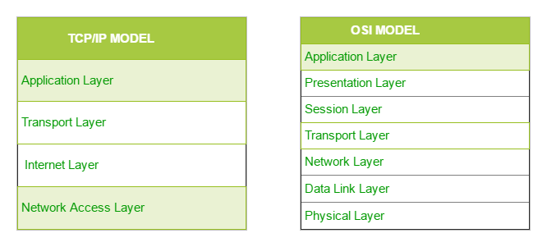

Slide 15
1 Network Access Layer
It defines how the data should be sent physically through the network.
This layer is mainly responsible for the transmission of the data between two devices on the same network.

Slide 16
2 Internet Layer
The main responsibility of the internet layer is to send the packets from any network, and they arrive at the destination irrespective of the route they take.

Slide 17
3 Transport Layer
The transport layer is responsible for the reliability, flow control, and correction of data which is being sent over the network.

Slide 18
4 Application Layer
An application layer is the topmost layer in the TCP/IP model.
It is responsible for handling high-level protocols, issues of representation.
This layer allows the user to interact with the application.

Slide 19
Establishing connectivity on the internet client ip address
Internet Service Provider (ISP) is a company offering access to internet. They offer various services:
Internet Access
Domain name registration
Dial-up access
Leased line access

Slide 20
ISP Types
ISPs can broadly be classified into six categories

Slide 21
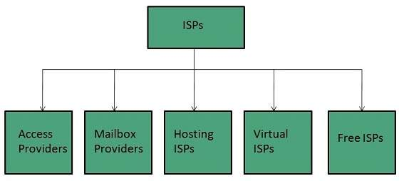

Slide 22
Access providers
They provide access to internet through telephone lines, cable wi-fi or fiber optics.
Mailbox Provider
Such providers offer mailbox hosting services.
Hosting ISPs
Hosting ISPs offers e-mail, and other web hosting services such as virtual machines, clouds etc.
Virtual ISPs
Such ISPs offer internet access via other ISP services.
Free ISPs
Free ISPs do not charge for internet services.

Slide 23
Connection Types
There exist several ways to connect to the internet. Following are these connection types available:
Dial-up Connection
ISDN
DSL
Cable TV Internet connections
Satellite Internet connections
Wireless Internet Connections

Slide 24
Dial-up Connection
Dial-up connection uses telephone line to connect PC to the internet. It requires a modem to setup dial-up connection. This modem works as an interface between PC and the telephone line.
There is also a communication program that instructs the modem to make a call to specific number provided by an ISP.
Dial-up connection uses either of the following protocols:
Serial Line Internet Protocol (SLIP)
Point to Point Protocol (PPP)

Slide 25
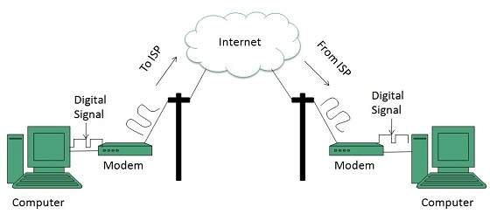

Slide 26
ISDN
ISDN is acronym of Integrated Services Digital Network. It establishes the connection using the phone lines which carry digital signals instead of analog signals.

Slide 27
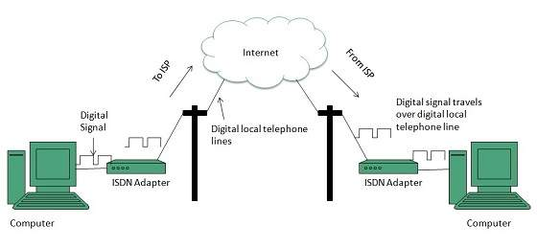

Slide 28
DSL
DSL is acronym of Digital Subscriber Line. It is a form of broadband connection as it provides connection over ordinary telephone lines.

Slide 29
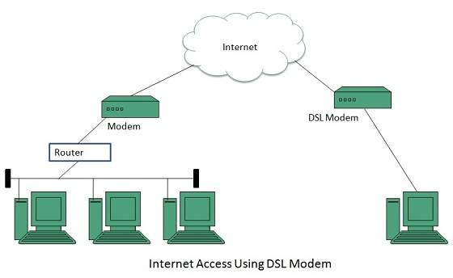

Slide 30
Cable TV Internet Connection
Cable TV Internet connection is provided through Cable TV lines. It uses coaxial cable which is capable of transferring data at much higher speed than common telephone line

Slide 31
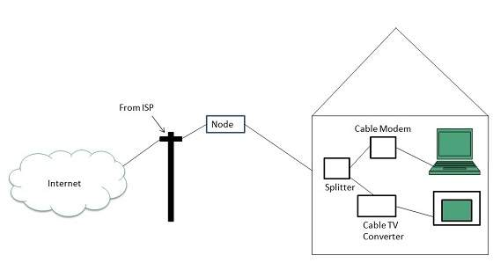

Slide 32
Satellite Internet Connection
Satellite Internet connection offers high speed connection to the internet. There are two types of satellite internet connection: one way connection or two way connection.
In one way connection, we can only download data but if we want to upload, we need a dialup access through ISP over telephone line.
In two way connection, we can download and upload the data by the satellite. It does not require any dialup connection.

Slide 33
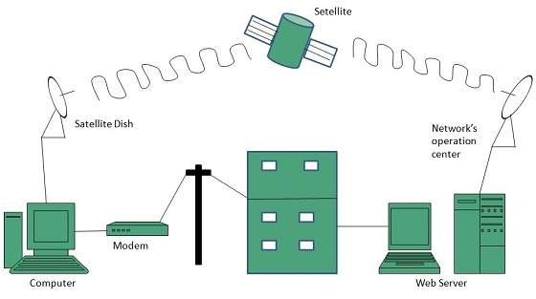

Slide 34
Wireless Internet Connection
Wireless Internet Connection makes use of radio frequency bands to connect to the internet and offers a very high speed. The wireless internet connection can be obtained by either WiFi or Bluetooth.
Key Points:
Wi Fi wireless technology is based on IEEE 802.11 standards which allow the electronic device to connect to the internet.
Bluetooth wireless technology makes use of short-wavelength radio waves and helps to create personal area network (PAN).

Slide 35
Client-Server
Client: When we talk the word Client, it mean to talk of a person or an organization using a particular service. Similarly in the digital world a Client is a computer (Host) i.e. capable of receiving information or using a particular service from the service providers (Servers).
Servers: Similarly, when we talk the word Servers, It mean a person or medium that serves something. Similarly in this digital world a Server is a remote computer which provides information (data) or access to particular services.

Slide 36
HTML
HTML stands for Hyper Text Markup Language
HTML is the standard markup language for creating Web pages
HTML describes the structure of a Web page
HTML consists of a series of elements
HTML elements tell the browser how to display the content
HTML elements label pieces of content such as "this is a heading", "this is a paragraph", "this is a link", etc.

Slide 37
The main parts of our element are as follows:
The opening tag: This consists of the name of the element (in this case, p), wrapped in opening and closing angle brackets. This states where the element begins or starts to take effect — in this case where the paragraph begins.
The closing tag: This is the same as the opening tag, except that it includes a forward slash before the element name. This states where the element ends — in this case where the paragraph ends. Failing to add a closing tag is one of the standard beginner errors and can lead to strange results.
The content: This is the content of the element, which in this case, is just text.
The element: The opening tag, the closing tag, and the content together comprise the element.

Slide 38
What is an HTML Element?
An HTML element is defined by a start tag, some content, and an end tag:
<tagname> Content goes here... </tagname>
The HTML element is everything from the start tag to the end tag

Slide 39


Slide 40
HTML Documents
All HTML documents must start with a document type declaration: <!DOCTYPE html>.
The HTML document itself begins with <html> and ends with </html>.
The visible part of the HTML document is between <body> and </body>

Slide 41
<!DOCTYPE html> <html> <body> <h1>My First Heading</h1> <p>My first paragraph.</p> </body> </html>

Slide 42
The <!DOCTYPE> Declaration
The <!DOCTYPE> declaration represents the document type, and helps browsers to display web pages correctly.
It must only appear once, at the top of the page (before any HTML tags).
The <!DOCTYPE> declaration is not case sensitive.
The <!DOCTYPE> declaration for HTML5 is:
<!DOCTYPE html>

Slide 43
HTML Headings
HTML headings are defined with the <h1> to <h6> tags.
<h1> defines the most important heading. <h6> defines the least important heading:

Slide 44
HTML Paragraphs
HTML paragraphs are defined with the <p> tag:
<p>This is a paragraph.</p> <p>This is another paragraph.</p>

Slide 45
HTML Links
HTML links are defined with the <a> tag:
<a href="https://daviet.com">This is a link</a>

